Slide 1
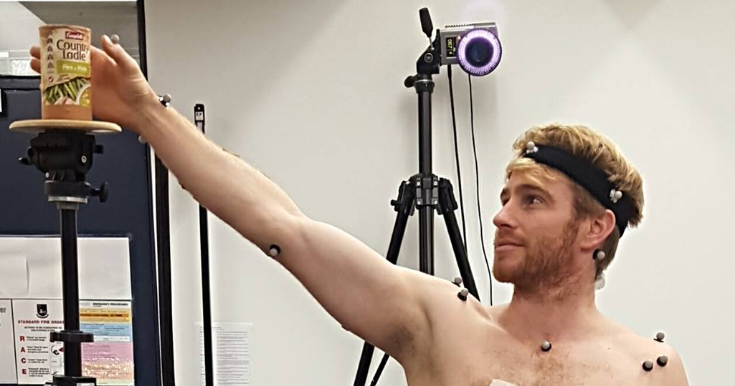
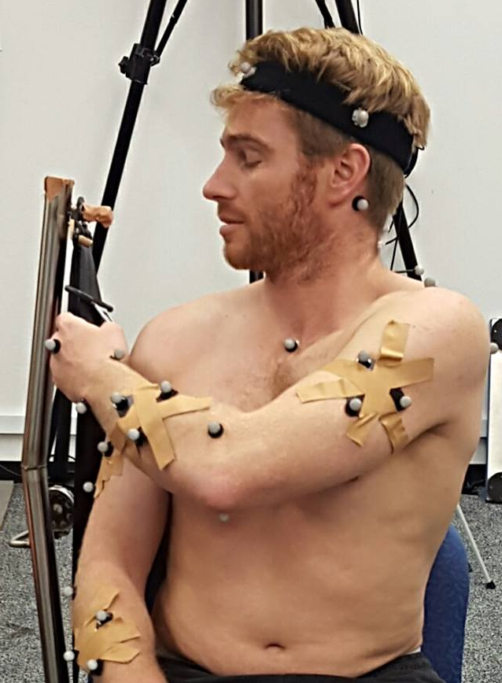



Altered movement strategies during functional tasks in individuals with chronic idiopathic neck pain
Snodgrass SJ, Cooper RA, Edwards S, Moghaddas D, Blyton SJ, de Zoete RMJ, Rivett DA
Newcastle
Neck
Pain
Group
Background
segment relative to neck segment [head-neck joint]; and head/neck segment relative to upper thoracic segment [head/neck-trunk joint]), peak and mean resultant head rotation velocity (cm/s), time from start to time of peak right rotation joint angle and resultant head rotation velocity (%), and mean hand segment velocity (cm/s). Self-reported pain intensity was defined as the average pain over the previous four weeks, measured using a 100 mm visual analogue scale anchored by ‘no pain’ on the left and ‘worst pain imaginable’ on the right. Neck disability was quantified using the Neck Disability Index (NDI) scored out of a total of 50. Between-group differences in movement variables were analysed using independent t-tests, and correlations between movement variables and pain and disability were determined.
100
Chronic idiopathic neck pain is costly and disabling.¹ Individuals with neck pain demonstrate reduced range of motion,² contributing to difficulties performing functional tasks. Aberrant movement strategies may perpetuate these difficulties and pain, but few studies have analysed neck kinematics during functional tasks.
80
Time of peak rotation
(% of movement)
60
40
Purpose
To determine differences in neck motion during functional tasks between individuals with chronic idiopathic neck pain and age and gender-matched healthy control participants, and whether movement performance is correlated with self-reported pain intensity and neck disability.
0
Pain
Healthy
Figure 3. Time of peak rotation later in pain group (mean difference 20.3%, 95% CI 4.2 to 36.5, p = .018).
10
Methods
Ten participants with chronic idiopathic neck pain (> 3 months) and 10 healthy control participants performed five repetitions each of two tasks (overhead reach to the right in standing, and putting on a seatbelt), Fig. 1A & B. During each task, three-dimensional kinematics were measured using six Oqus 300 cameras (Qualisys, Sweden). Movement phase for each task was defined when the hand segment (‘reach’) or hand marker (‘seatbelt’) velocity was zero, just before the initial hand movement (start), and when the participant grasped the object (end). Kinematic variables calculated during each phase were: peak joint angle and range of motion for right rotation and flexion-extension joint angles (°, head
8
Peak head rotation velocity (cm/s)
Results
Mean pain intensity was 45.2mm (SD 16.3, 95% CI 33.5 to 56.9, range 18-74), and NDI 14.2 (SD 3.6, range 8-19) for participants with neck pain. During overhead reach to the right, peak resultant head rotation velocity was significantly less (Fig. 2), and the time of peak right rotation head-neck joint angle was significantly later in participants with neck pain (Fig 3). For overhead reach, higher neck disability was significantly correlated with lower peak (r = .788, p = .007) and mean head rotation velocity (r = .651, p = .041). Other variables for the reach and seatbelt task were not significantly different between groups or correlated with pain or disability.
6
4
2
0
8
10
12
14
16
18
20
Neck Disability Index (0-50)
Figure 4. Higher neck disability correlated with lower head rotation velocity (r = .788, p = .007) .
Conclusion
Individuals with chronic idiopathic neck pain move their head slower than healthy individuals during a reaching task, and the slower the velocity the greater neck disability. They also demonstrate different timing of head movement in relation to the task, suggesting altered coordination of movement.
15
References
Hoy D, March L, Woolf A et al. The global burden of neck pain: estimates from the Global Burden of Disease 2010 study. Ann Rheum Dis 2014;73:1309-15.
Snodgrass SJ, Cleland JA, Haskins R, Rivett DA. The clinical utility of cervical range of motion in diagnosis, prognosis, and evaluating the effects of manipulation: a systematic review. Physiotherapy 2014;100:290-304.
10
Peak head rotation velocity (cm/s)
Figure 2. Slower head rotation velocity in pain group (mean difference 2.4 cm/s, 95% CI 0.2 to 4.6, p = .034).
5
Figure 1. Ending position for analysis of (A) the overhead reach task in standing, and (B) the seatbelt task.
Acknowledgements
0
Pain
Healthy

